Slide 1
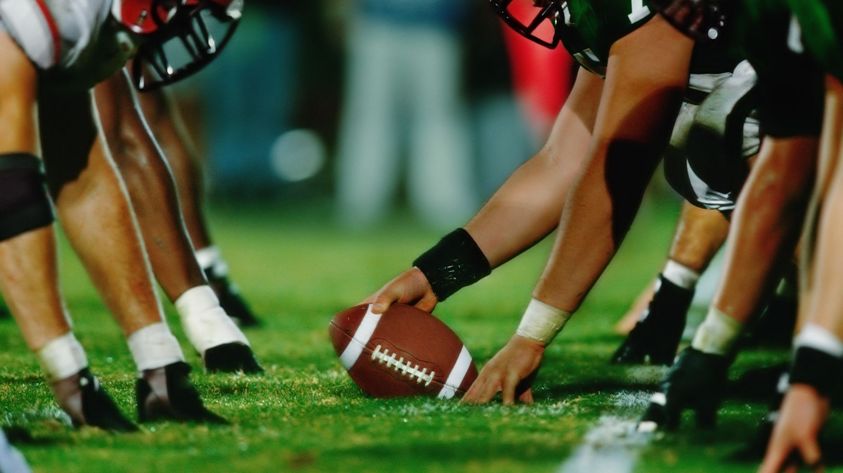
How the NFL Running Back Position Has Changed Since 1966
By: Luke Scott

Slide 2

What is a Running Back (RB) in the NFL?
Receive handoffs from the Quarter Back
Run the ball
Block
Line up as a wide receiver to catch the ball

Slide 3
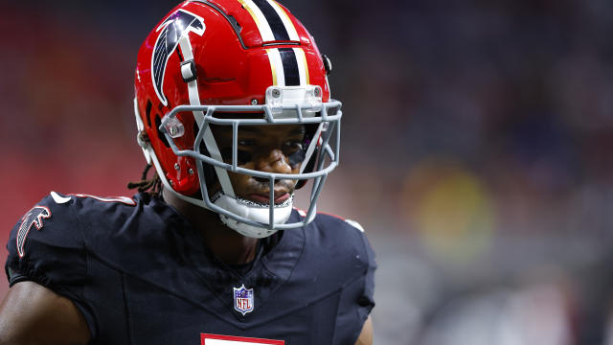
Importance of a Running Back
Quarterback
Pass Rusher 1
Left Tackle
Left Cornerback
Wide Receiver 1
Defensive Tackle
Running Back
Pass Rusher 2
Middle Linebacker
Tight End

Slide 4
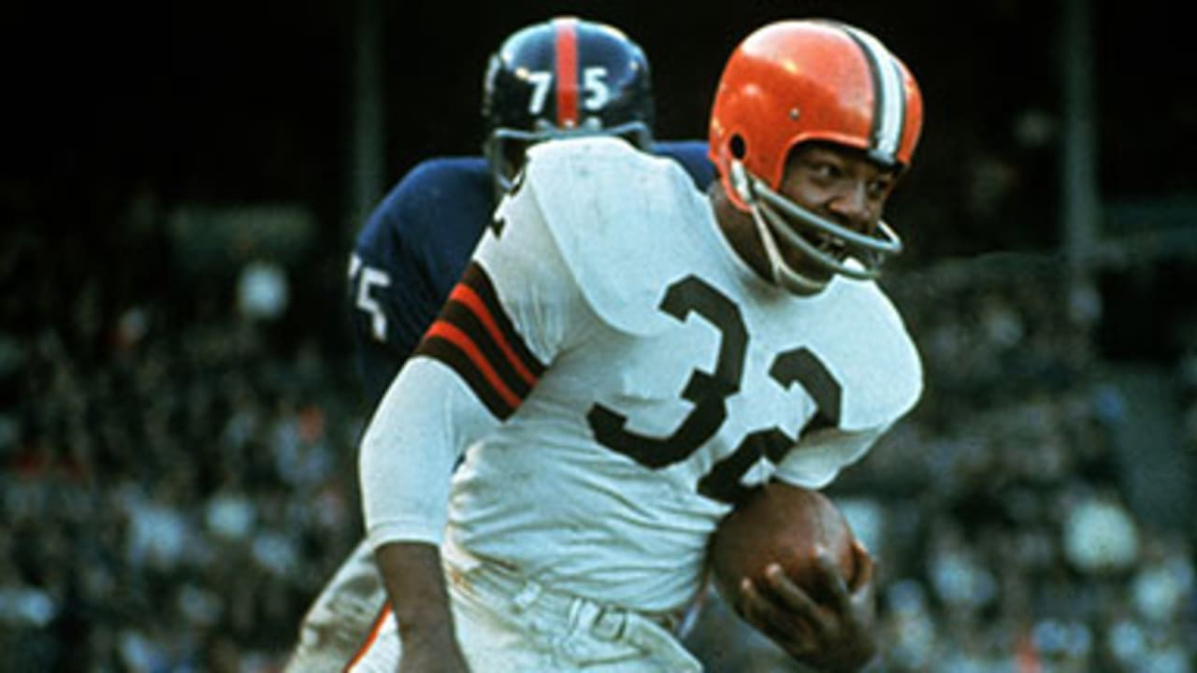
Was This Always the Case?
Were RB’s ever viewed higher than 7th most important?
Were RB’s used differently in the past?
How can you determine this?

Slide 5
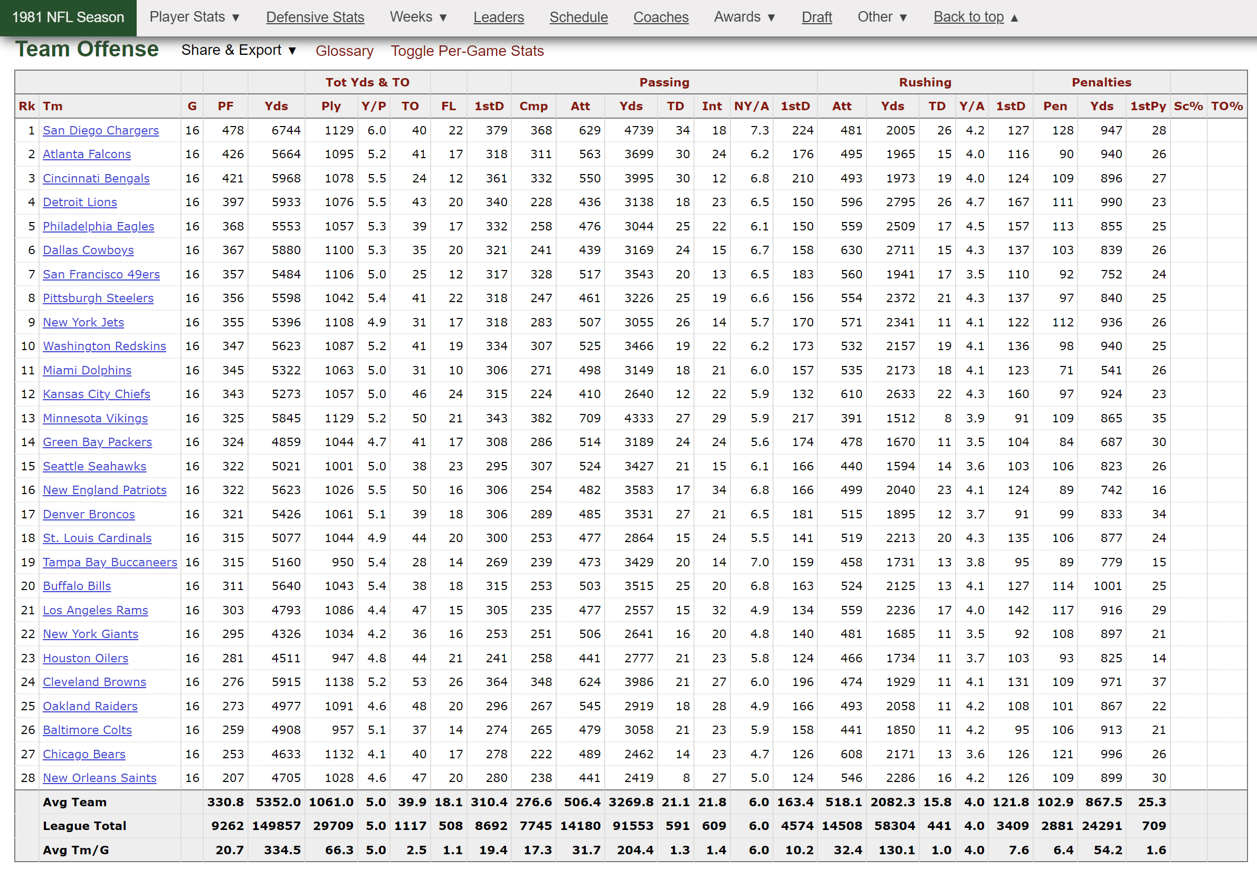

Stats

Slide 6
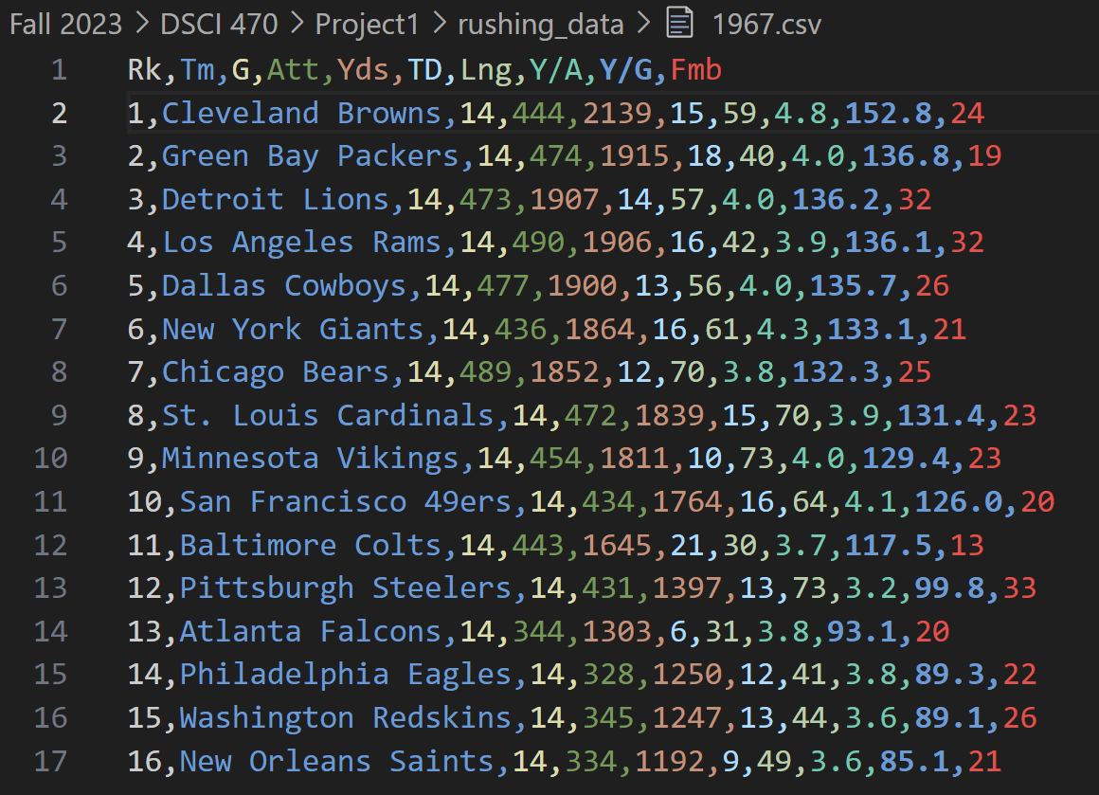
Formatting

Slide 7
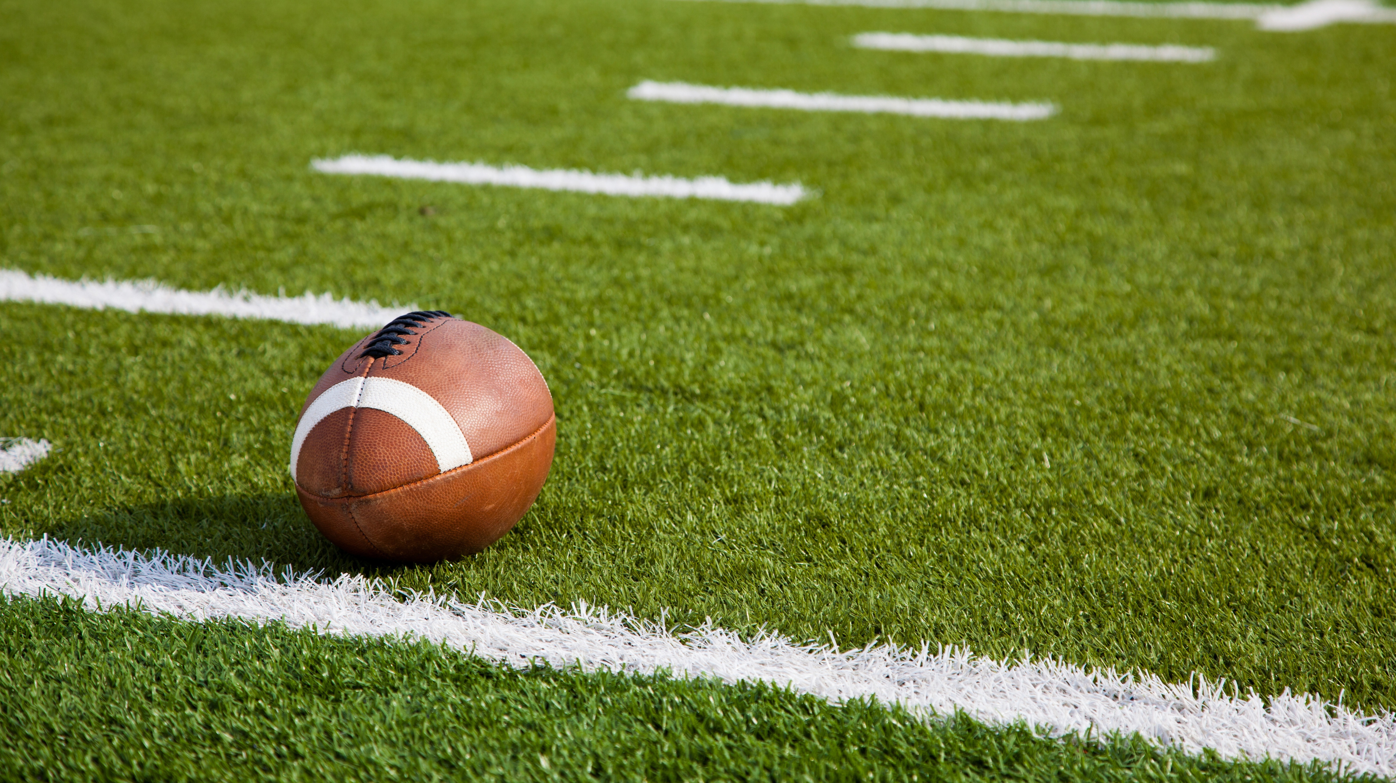
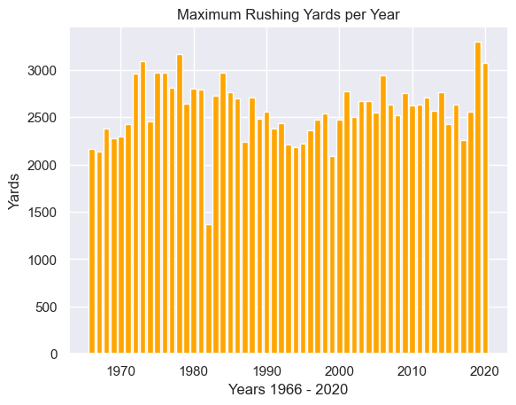
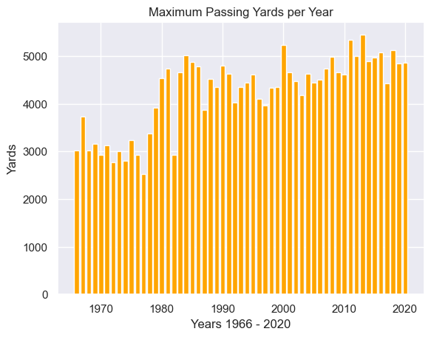
Maximum Yards per Year

Slide 8
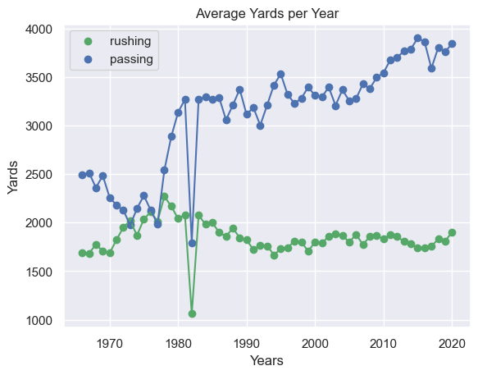
Average Yards per Year

Slide 9
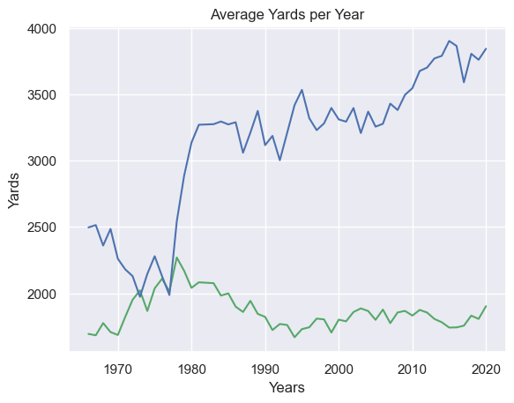
Average Yards per Year

Slide 10
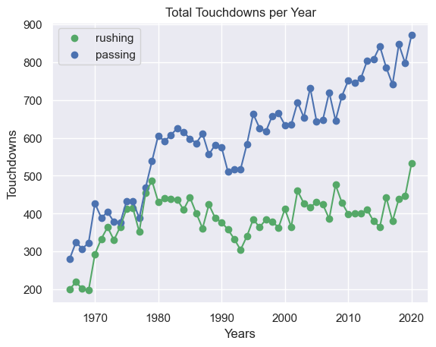
Total Touchdowns

Slide 11
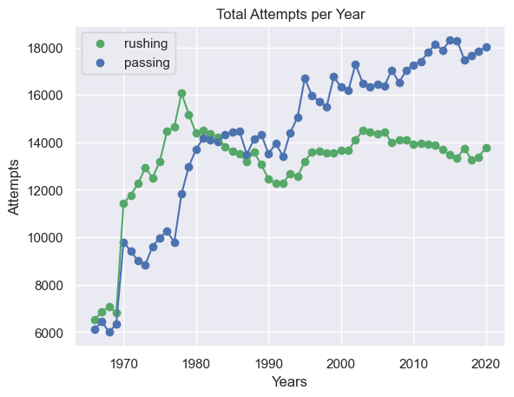
Total Attempts

Slide 12
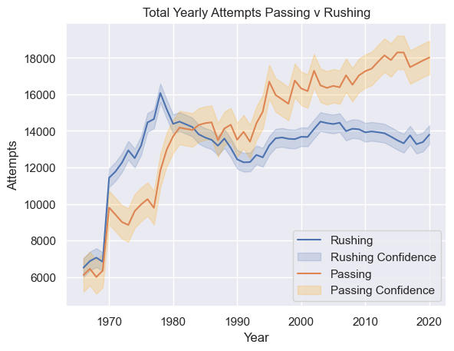
Total Attempts Confidence Interval

Slide 13
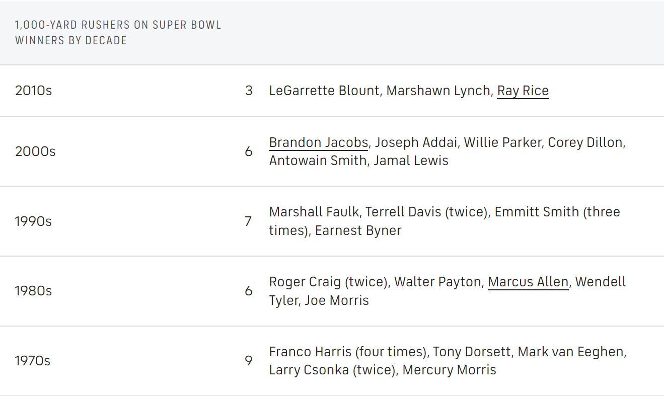

Slide 14

Conclusion
Running backs have definitely changed, primarily around the 1970’s-1980’s
Receiving has gotten much more standard
The yards gained from receiving is much higher
Most modern running backs tend to receive just as much

Slide 15
Sources
https://www.cbssports.com/nfl/news/reality-of-being-an-nfl-running-back-why-the-position-has-been-devalued-and-how-we-got-to-this-point/
https://www.pro-football-reference.com
https://journals.lww.com/nsca-jscr/fulltext/2020/03000/a_comparison_of_the_national_football_league_s.20.aspx
https://journals.lww.com/nsca-jscr/fulltext/2011/10000/positional_physical_characteristics_of_players.4.aspx
https://journals.sagepub.com/doi/10.1177/17479541211069338

Slide 16

Questions?

